Slide 1

Group 1: Project Proposal
Team Members:
Yinus Alamutu, Girish Bhuteja, Ethan Nguyen, Rian Sanchez,

Slide 2

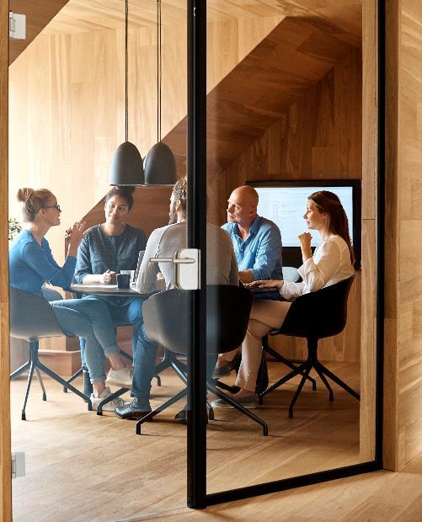


Introduction

Slide 3
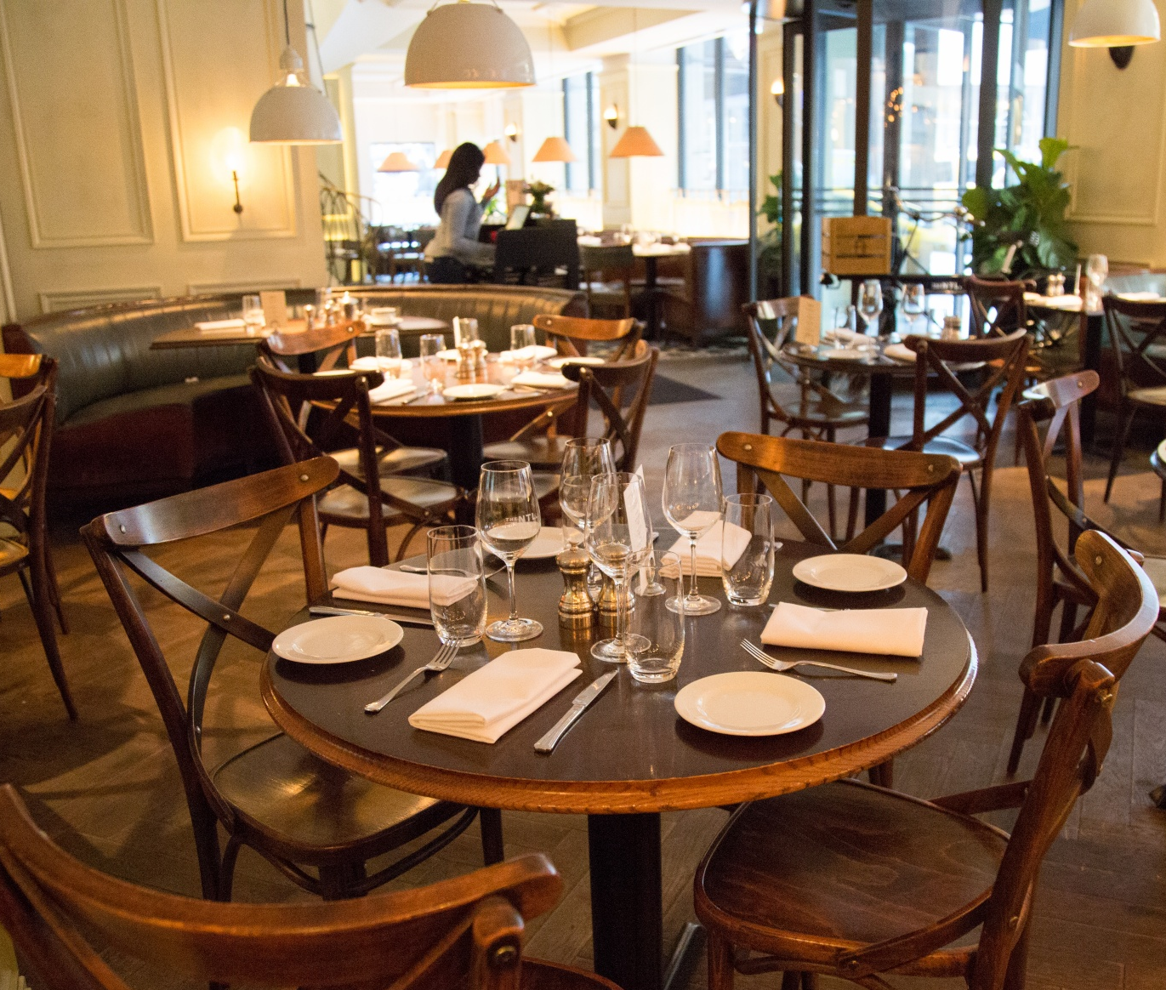
PROBLEM
In today's lifestyle, everyone is so busy with their hectic schedule and does not have time to waste.
In the system going on in most of the restaurants all over the world, the customers have to order their stuff by calling the servers, and sometimes they even have to wait for the servers to take their order. This can even result in miscommunication and errors. Moreover, sometimes, this can lead to frustration for the customers.
This may lead to poor customer experience, directly affecting the business and its operations.

Slide 4
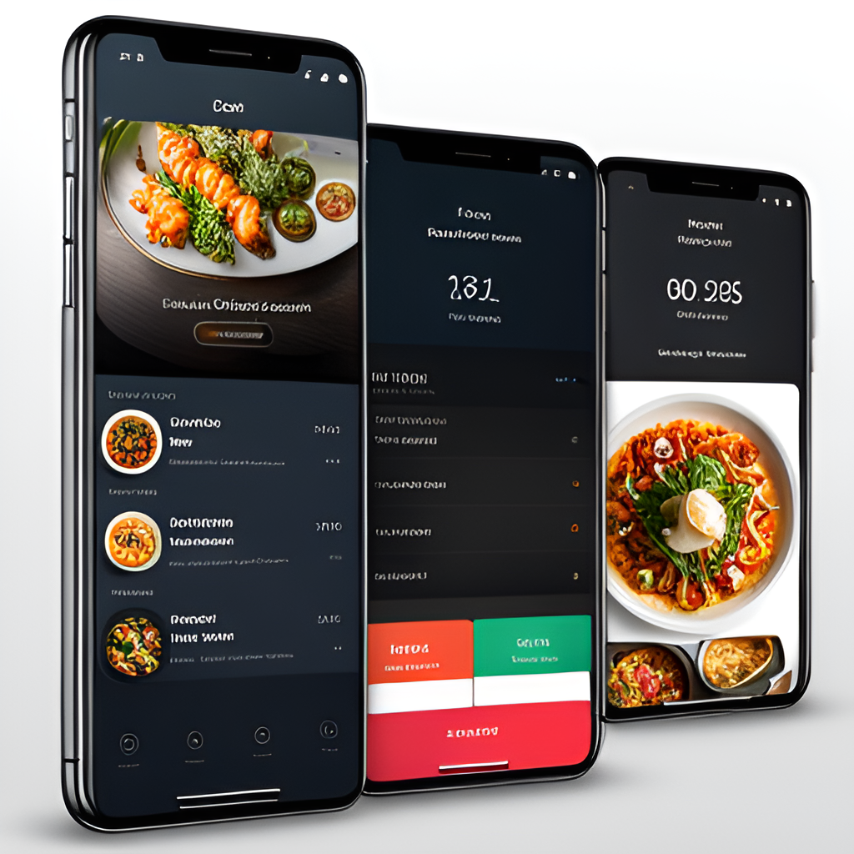
SOLUTION
Looking at the problem, we have thought to make a food ordering interface which would help the customer order the food without delay, saving much time.
Customers could easily browse the menu, select their dishes, add them to the card, and place the order.
This would be much faster and more accurate (with fewer chances of miscommunication).
Customers can also write additional comments before ordering.
My following team members would discuss the rest of the functions.

Slide 5

CUSTOMERS
SAVES TIME
ACCURACY
CAN TRACK ORDER
VISUAL MENUS AVAILABLE
CAN CUSTOMIZE THE DISHES
RESTAURANT
CUSTOMER SATISFACTION
RELIABLE
BUSINESS BENEFITS
INTEGRATE WITH INVENTORY OF STOCKS
This Photo by Unknown author is licensed under CC BY-SA.

Slide 6

Major Classes Used
Orders
Customers
Food_Items

Slide 7

Important Methods Of The Order Class
void init_order(int table_number, char* order_status, char* order_time)
Purpose: This function initializes an order for a specific table.
Behavior: It sets up the initial state of an order, including assigning a table number, setting the order status, and recording the time of order initiation.
void update_status(char* order_status, const char* new_status)
Purpose: This function updates the status of an existing order
Behavior: It modifies the order status to reflect changes in the order's progress or state. The new status is provided as an argument.
void get_info(int order_number, const char* order_status, const char* order_time)
Purpose: This function retrieves information about a specific order.
Behavior: It retrieves and provides information about a particular order, including its number, current status, and the time it was initiated. The information is stored in the provided pointers.

Slide 8

Important Methods Of The Food Item Class
void init_food_item( const char* name, float price, int amount, const char* description, const char* note)
This function is responsible for initializing a food item with the provided details such as name, price, amount, description, and note.
void update_price_components(float* item_price, float new_price)
This function updates the price of a food item. It takes a pointer to the current price (item_price) and the new price to update.
void get_info(const char* item_name, float item_price, int item_amount, const char* item_description, const char* item_note)
This function is to display information about a food item. It takes parameters representing the name, price, amount, description, and note of the item.
void update_description(char* item_description, const char* new_description)
This function updates the description of a food item. It takes a pointer to the current description (item_description) and the new description to update.

Slide 9

Important Methods Of The Customer Class
//For getting the information of the customer
void get_info(const char* name, char customer_order);
//initializing customers with their names and table number
void init_customer( const char* name, int table_number)

Slide 10
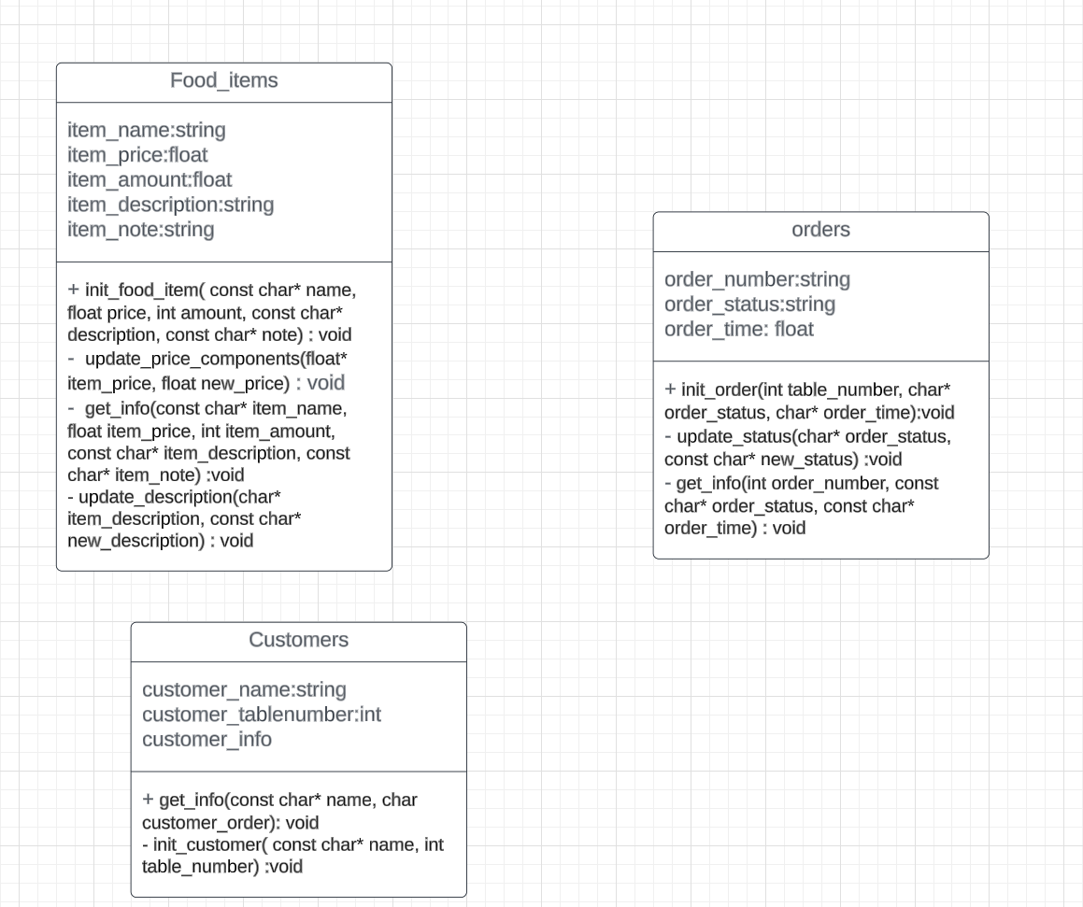
Brief Overview Of The Class Diagram
Private and Public attributes
Method description

Slide 11
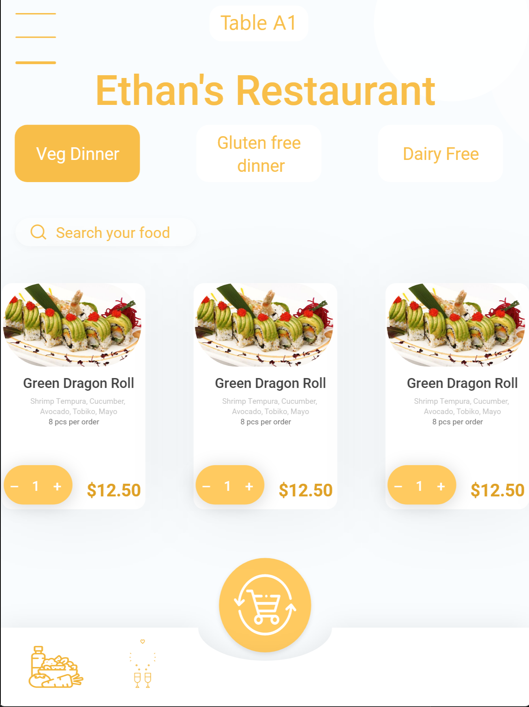
What is the SCADA/HMI design monitoring?
Customer Perspective
They need to be able to see a menu of possible food to order.
They need to be able to see the food added to their order.
They need to be able to confirm the order was received by the Central Database. (That the order was sent and properly received from the tablet device)
They will want to know how long their food will take to be completed and served, if there are any delays to their food, etc.
They will want to know that their food is on the way.

Slide 12
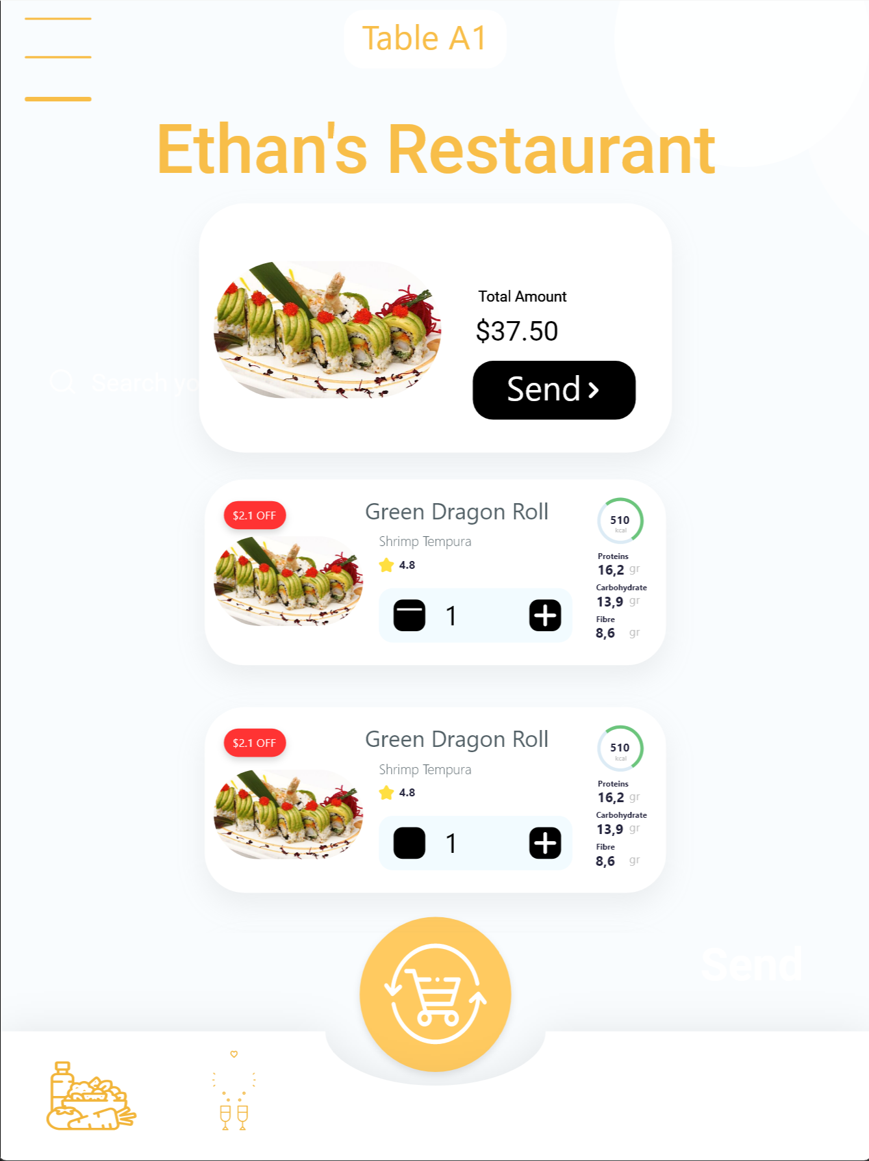
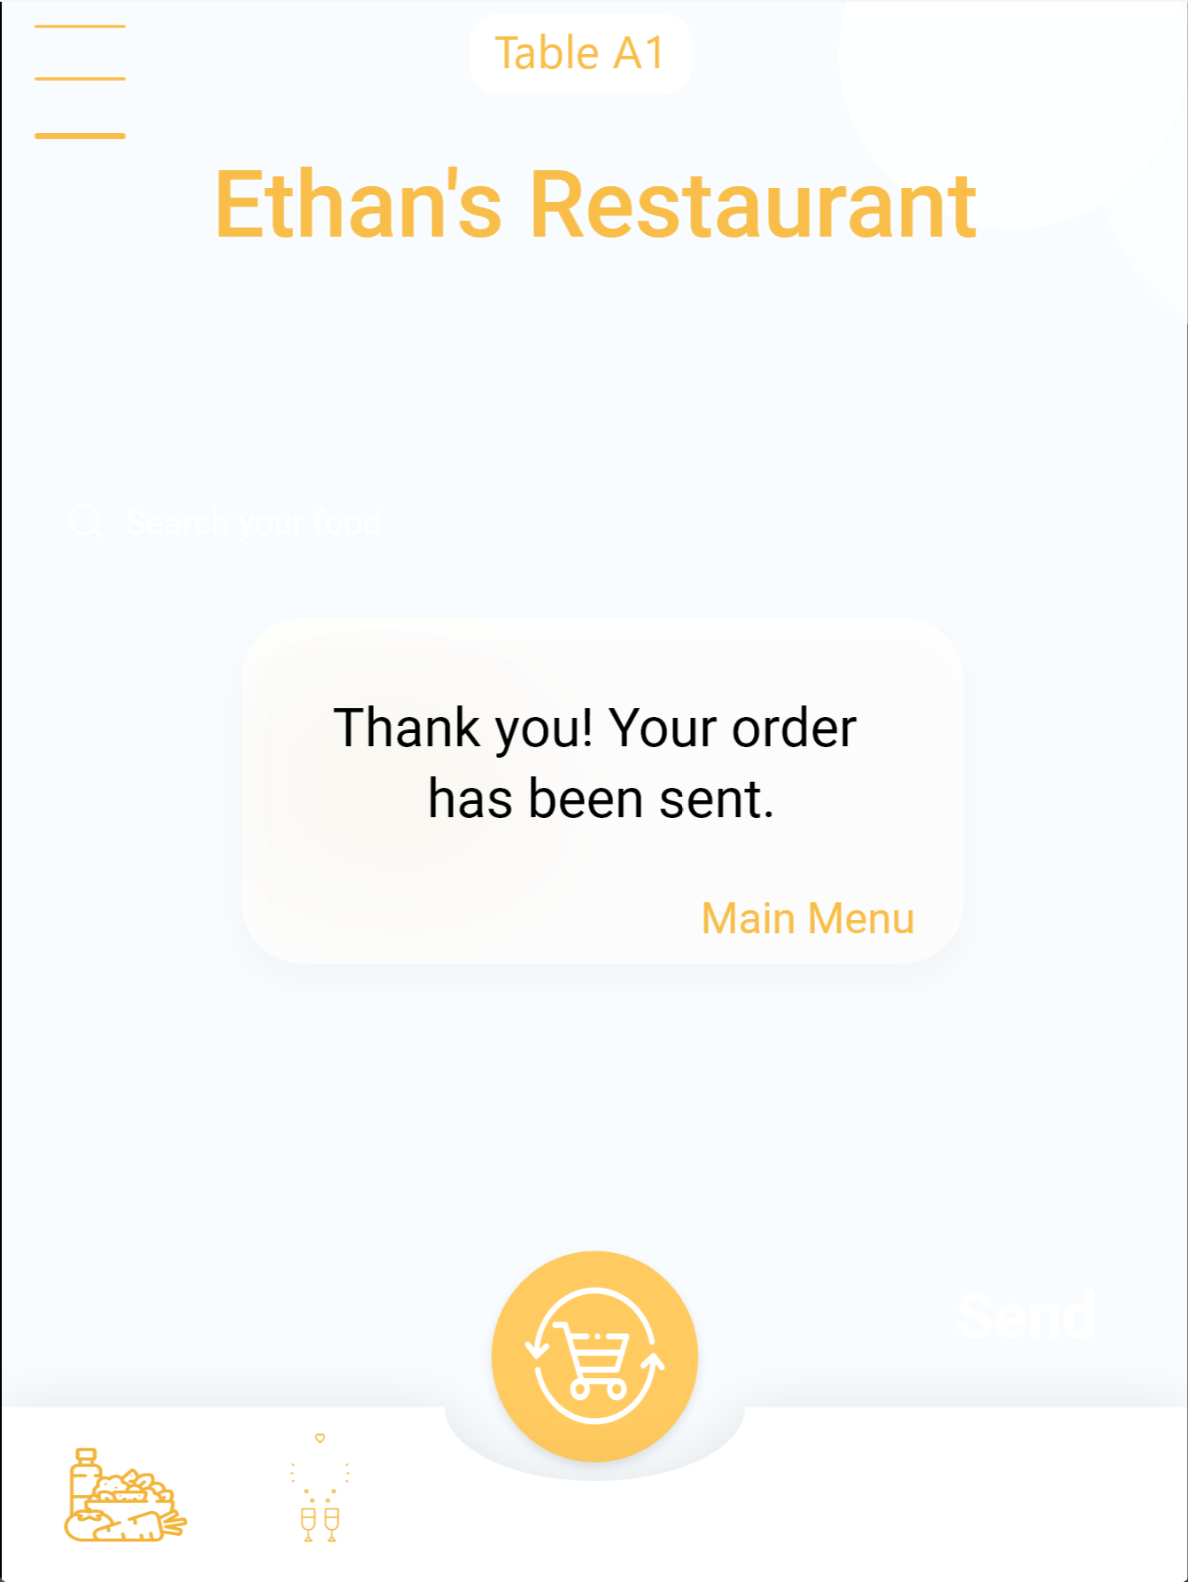

Slide 13
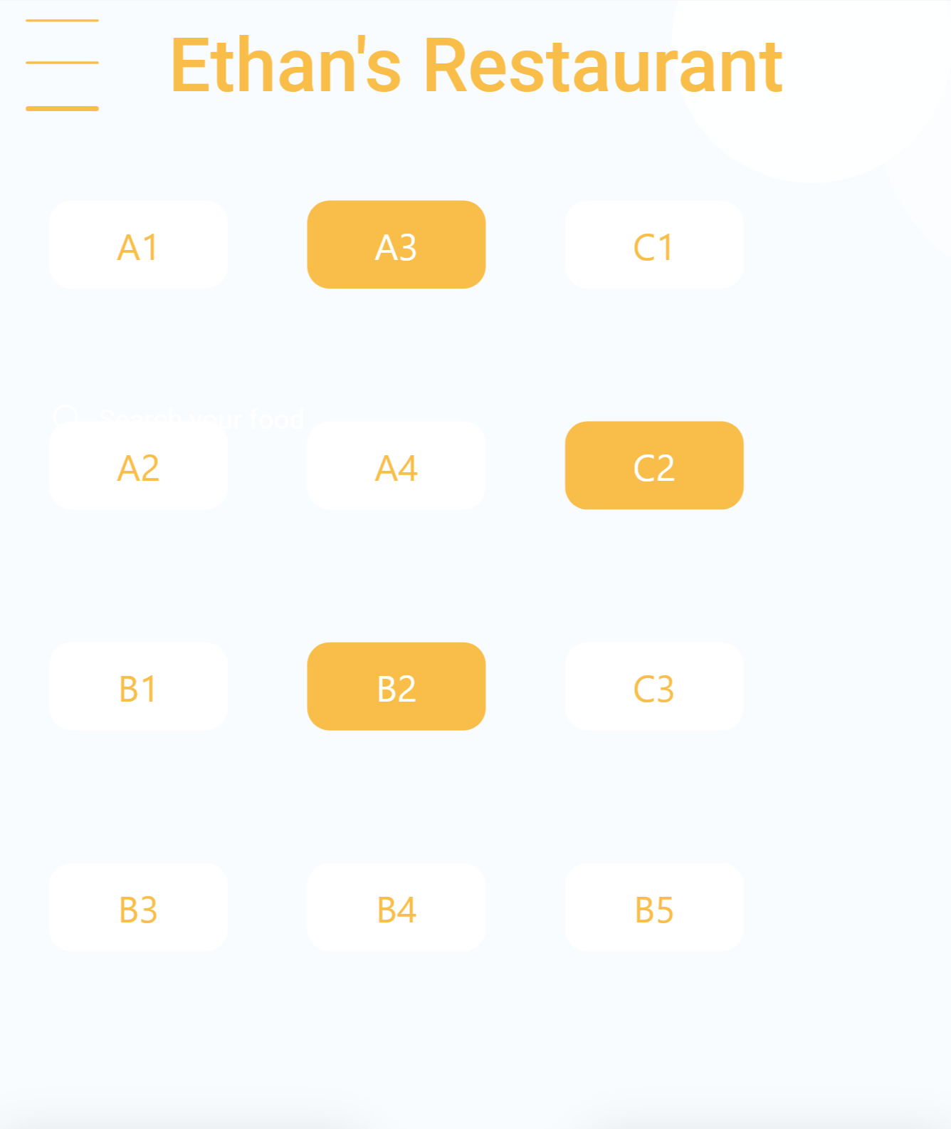
Kitchen Perspective
They need to be able to see the orders along with notes or customization from customers.
They need to be able to see the dishes that have been served to customers.
They need to be able to set the time they need to prepare the orders (estimated time), and they can inform the delay of the orders .
They should be able to see the seating time from the tables in order to have priority.

Slide 14
Server Perspective
They need to see all the orders of the customers based on their table number, and it should be sorted by time (the one who ordered first should be at the top).
They need to get the alert notification when the food is ready to be served.
They need to see the status of the food, like it is under progress or prepared. (or delayed)
They need to have an option to update the information about the food , for example: It has been served.

Slide 15
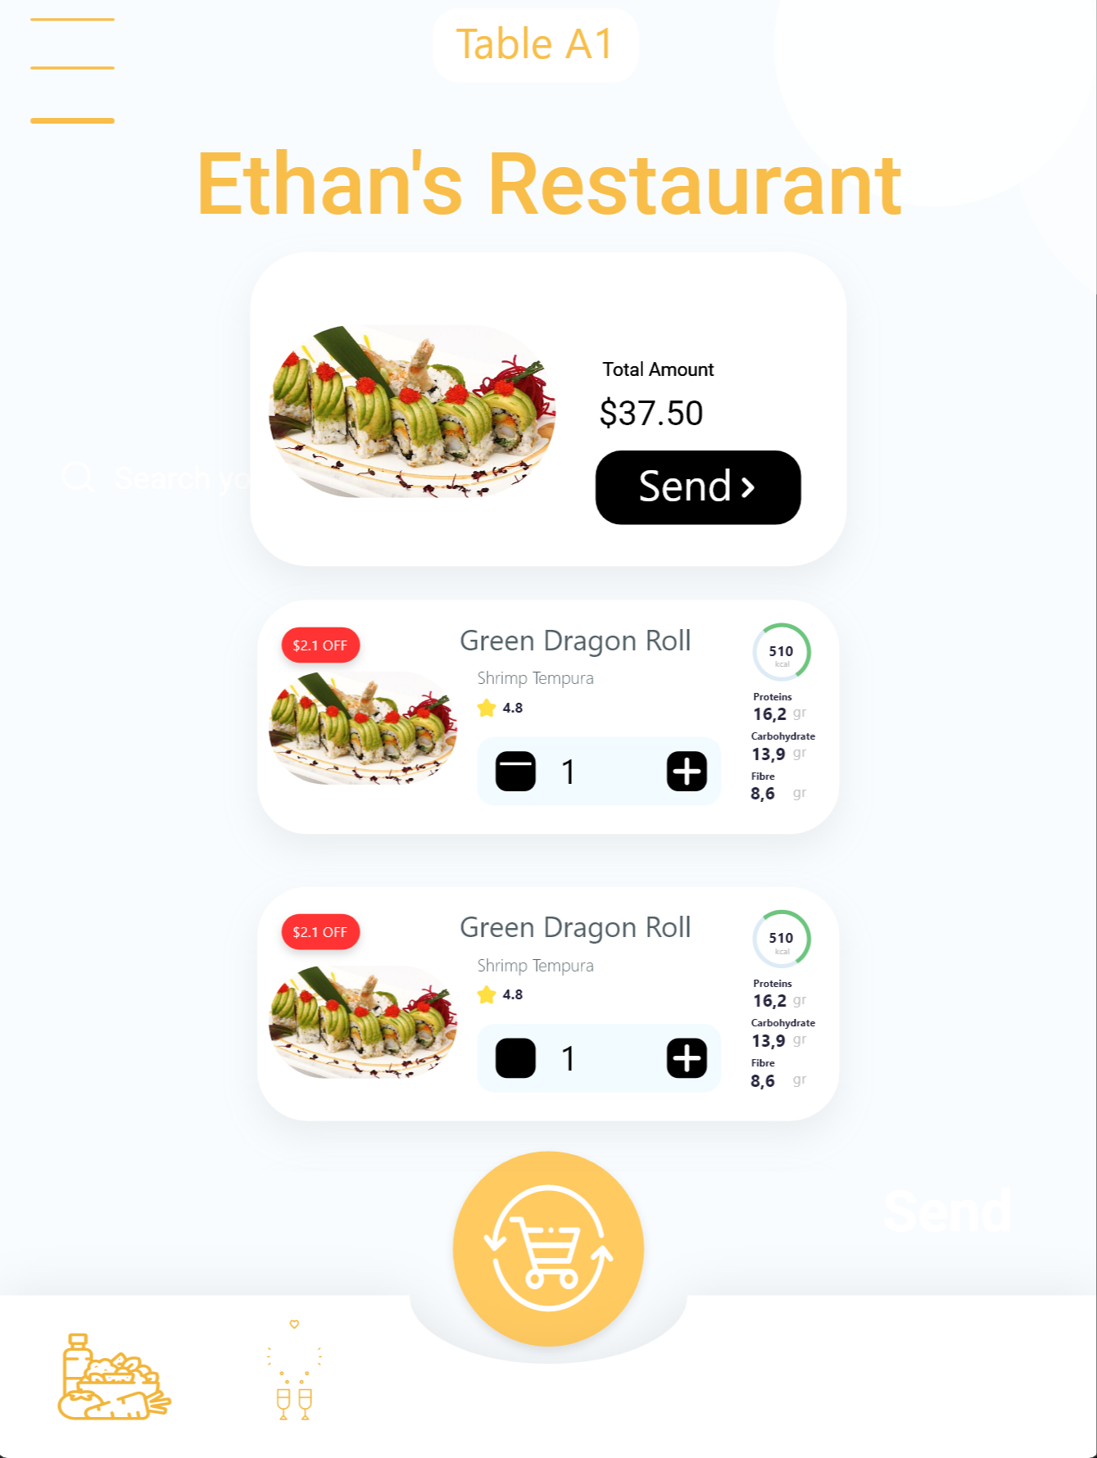
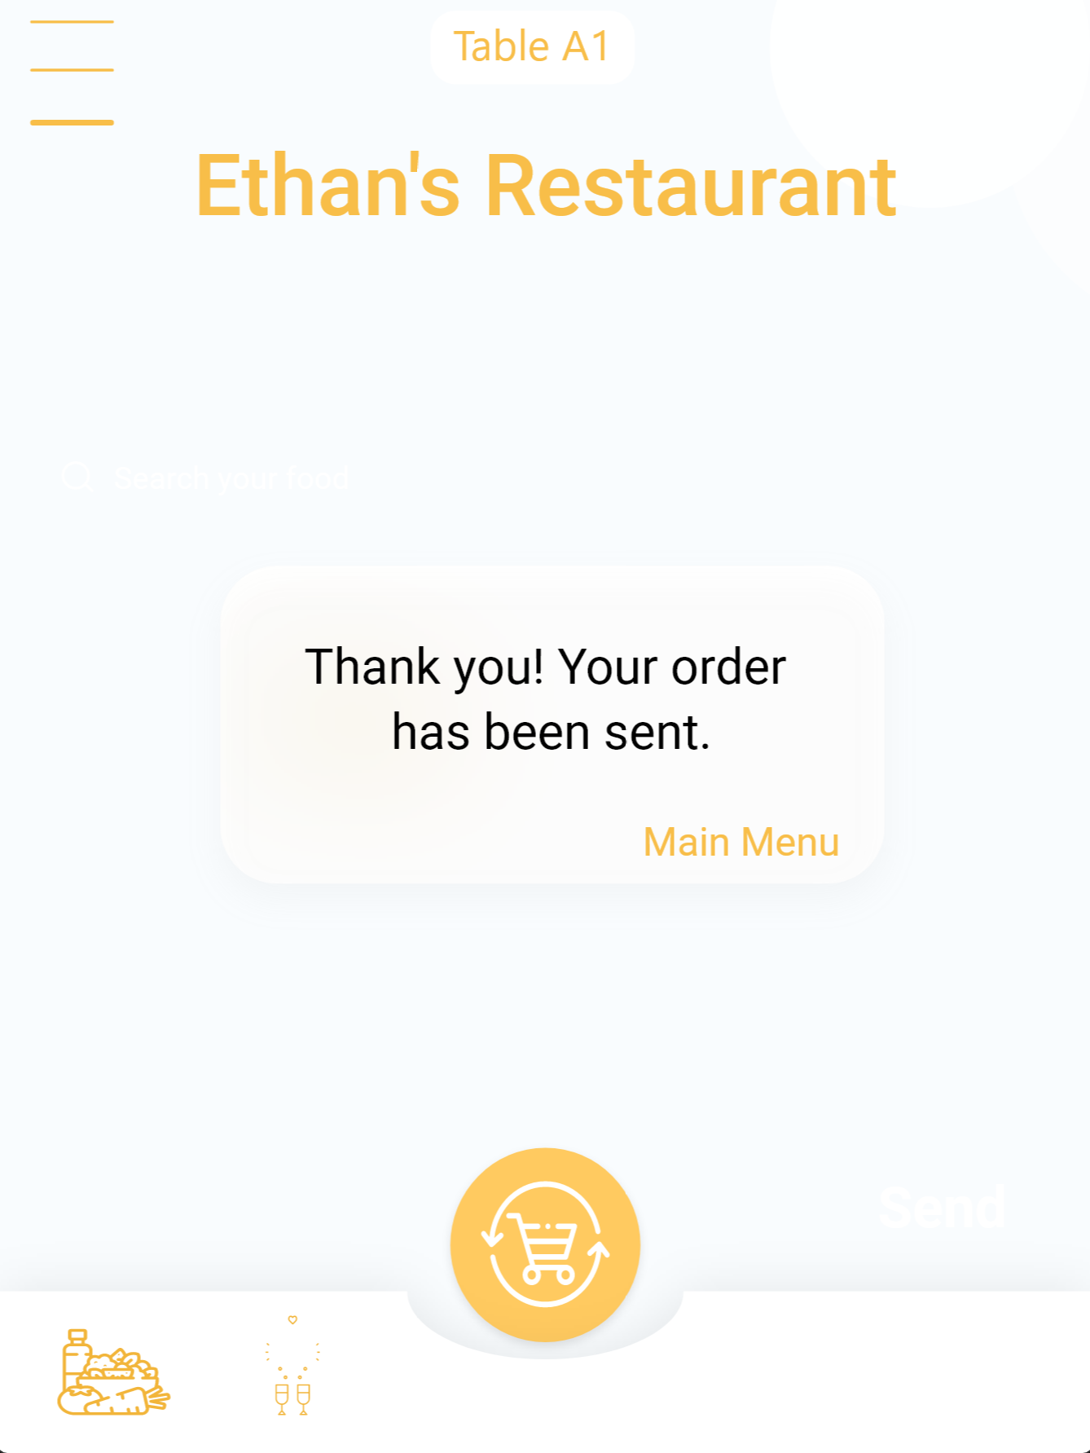
How will the users interface with product
Customer
Users will be able to choose the form of meal they want, e.g (Lunch, Supper, Dinner).
Users will be able to order by adding items and press send when they’re ready.
Users will be able to add notes or customization to their order in the note boxes.
Users will be able to order multiple times.
Users will be able to call server for help.
Users will be able to input the amount of money they want to tip the server.
Users will be able to remove orders from the cart at check-out menu

Slide 16
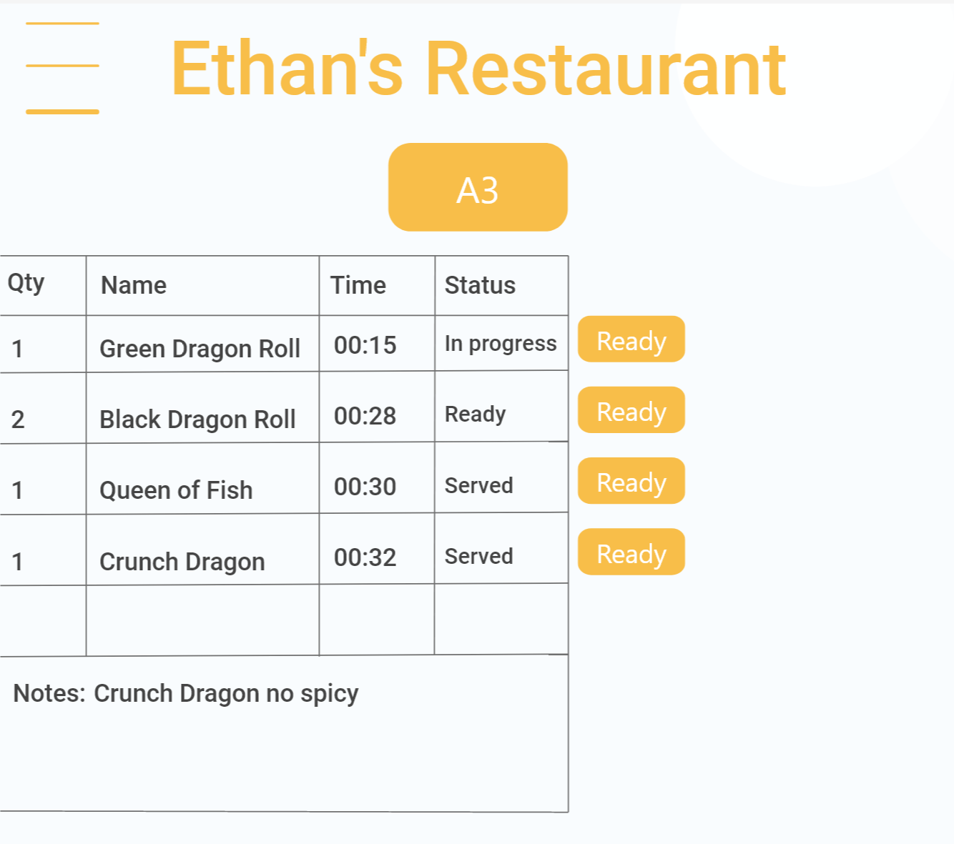
Kitchen staffs
Chefs will be able to press confirmation with the orders that have been sent from customers.
Chefs will be able to set the time they need for preparation.
Chefs will be able to delay the order.
Chefs will be able to press ready to let servers know to serve the food.

Slide 17
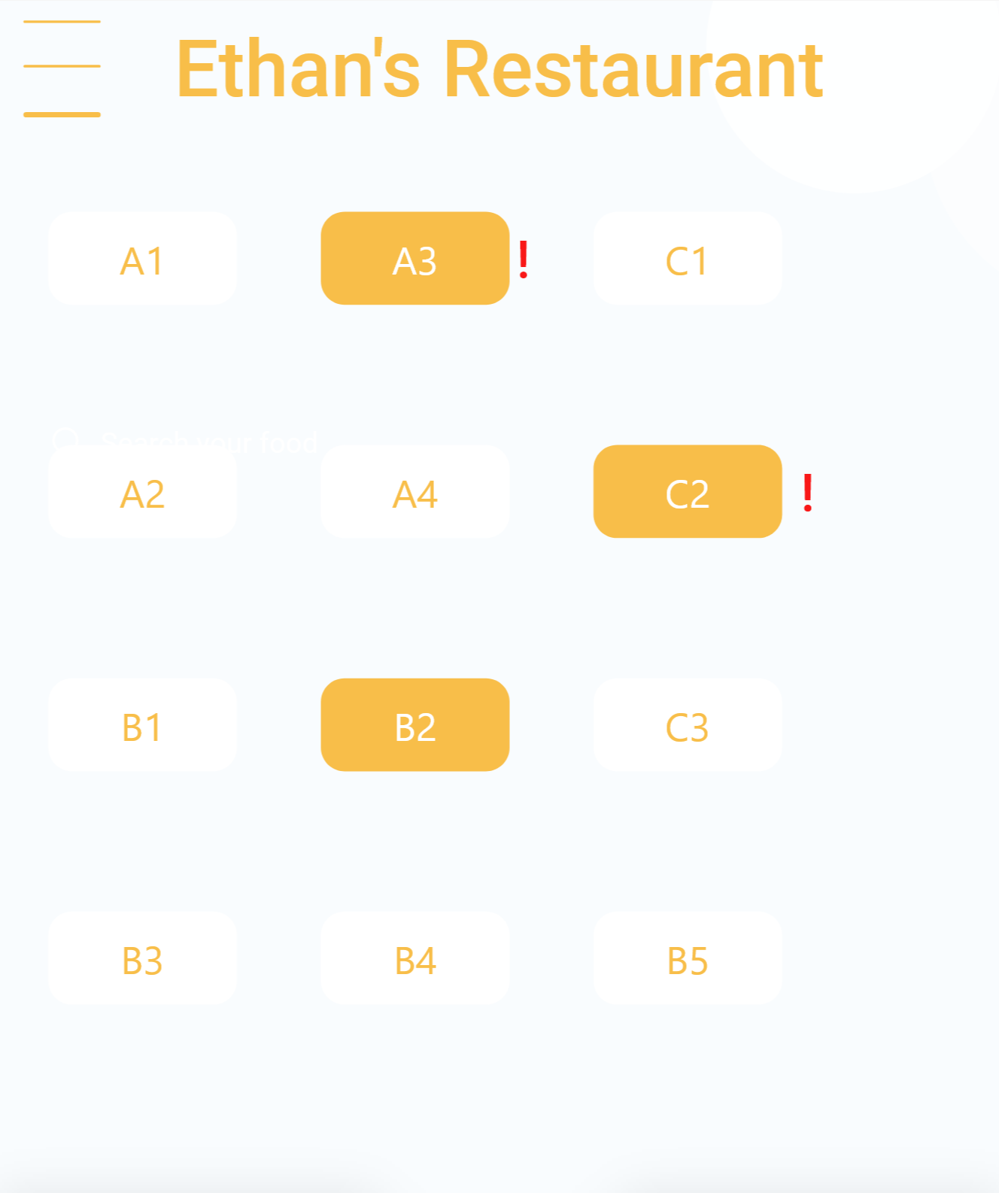
Servers
Servers will be able to see orders from tables.
Servers will be able to see when there is a dish ready to be served from the kitchen.
Servers will be able to see when customers want to pay or call server.

Slide 18

DATAFLOW

Slide 19
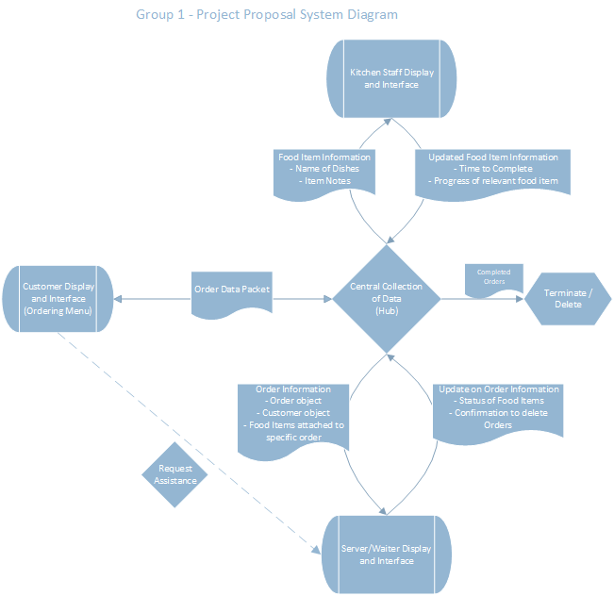
Data Flow - Overview
Data flow within our system is not linear
Interfaces can create and update existing information
All interfaces send data to the hub
Only the Hub System has access full order information
Call data in a singular place
Keeps Consistent Information
Also responsible for deleting Orders
Updates to information is reflected across all interfaces
Diagram available in Group 1’s Team Files

Slide 20
Data Flow – Packet Details
Customer Interface/Display
Kitchen Interface/Display
Waiter Interface/Display
Responsible for creating the primary data packet
Contains Order object, Customer Object, and all Food Item Objects associated with their order
A delivered data packet can not be edited by customer
Receives information regarding sent orders, but can not edit the information
Received information includes Order Status, and expected wait time
Can also send request for assistance by Server/Waiter
Receive information from customer orders,
Food item object(s)
Name of dish, amount, and customer note
Send details about the expected completion time, and status of individual dishes (Queued, Cooking, Cooked)
Receives Customer Information and Order and Dish status
Customer Objects and Order objects
Sends Updates to the Order Status (In-Progress, Completed), and updates the status of Food Items (from Cooked to Served)
Receives Assistance Requests from Customers
Contains Table Number
Also sends confirmation to delete order data for completed orders

Slide 21

TIMELINE

Slide 22


Thank You

